Slide 1
Solving 2048 Through AI
By Peter Dang, Katie Richardson, and Nathan Russo
CSCI-331 Introduction to Artificial Intelligence
Section 6, Group 7
12/5/2025

Slide 2

What is 2048?
2048 is a game with the goal of generating the highest numbered piece on a 4x4 board.
All pieces on the board have a value of 2^n.
The initial board is generated with a 2 or 4 (twice) in a random open location.
The player slides the pieces in a cardinal directions, combining equal pieces into the sum of their parts.
After each shift, a 2 or 4 is placed in a random open cell on the board.
Despite its name, the 2048 can continue after the 2048 (2^11) piece is generated.

Slide 3
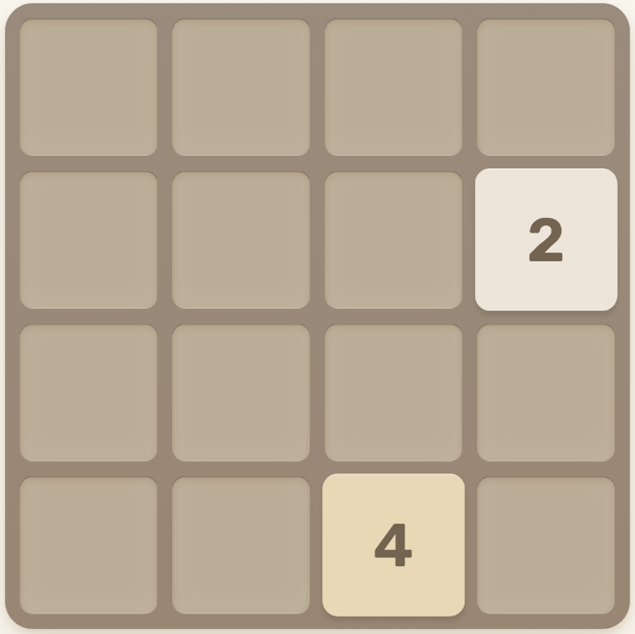
Searching to Solve 2048
For this project, our group was tasked with implementing 2 search algorithms that could achieve the 2048 square on their own.
Despite the board having only 16 cells, the random generation, placement, & probability of a 2 or 4 posed an interesting challenge.
After each shift, there are 2 * (# of open cells) possible boards. Additionally, 2’s spawn with a 90% probability while 4’s spawn with 10%.
Our group decided to implement the Expectiminimax (EMM) and Monte Carlo Tree Search (MCTS) algorithms to solve 2048.

Slide 4
What is Expectiminimax?
Expectiminimax (EMM)- A modification of minimax that takes into account randomness.
Max Player (MaxP): Normal player who is sliding pieces.
Min Player (MinP): The spawning of the 2 and 4 pieces.
The effectiveness of EMM is dependent on its search DEPTH.
The larger the DEPTH, the better EMM performed but the longer each decision takes.
For our computers, 3 or 4 is a good DEPTH, but that value can be taken higher if time is not an constraint.

Slide 5
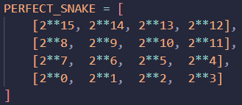
How does EMM Work?
Algorithm:
If DEPTH = 0: The value of the board is calculated using a snake heuristic and returned.
If MaxP’s Turn: The 4 cardinal moves are simulated, and EMM is called on each new board with depth - 1. Then it returns the best board value of the 4 moves.
If MinP’s Turn: All open cells placements are simulated, and EMM is called for both a 2 or 4 placement with depth - 1. The weighted average of the 2 and 4 boards is taken, and the average score of all open cells is returned.

Slide 6
Expectiminimax Demo

Slide 7
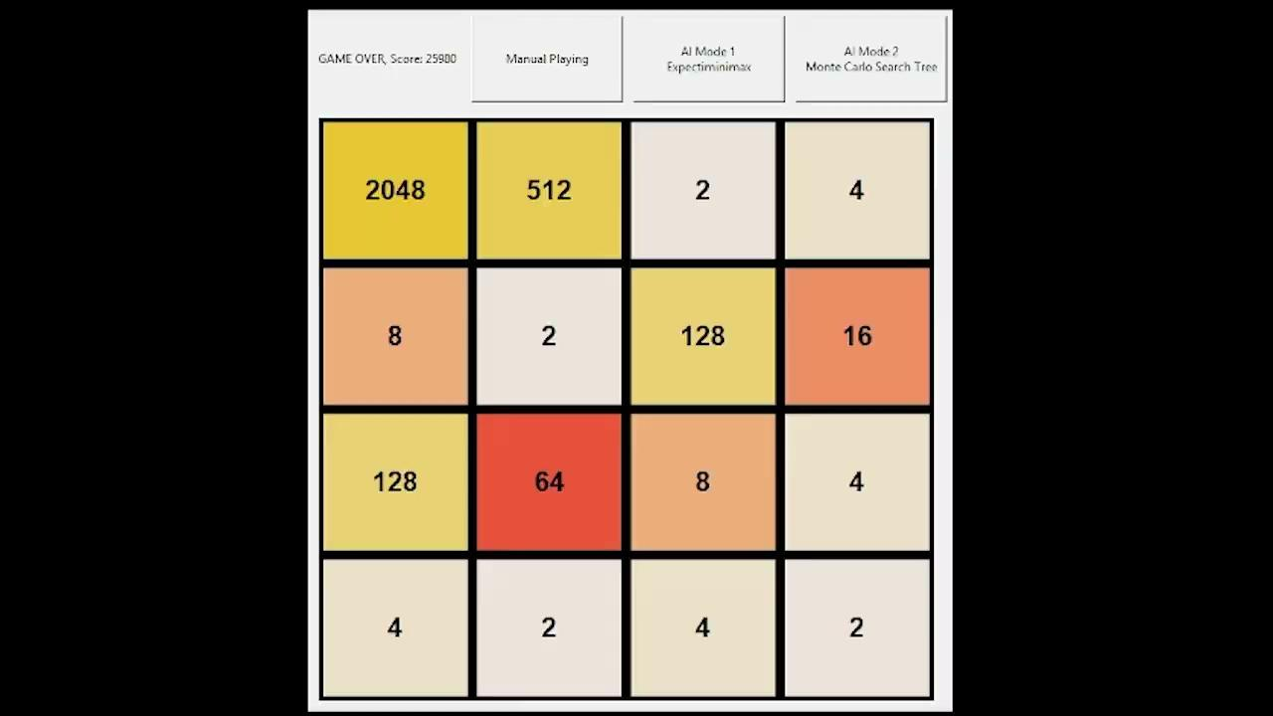
Expectiminimax Demo - 3s

Slide 8
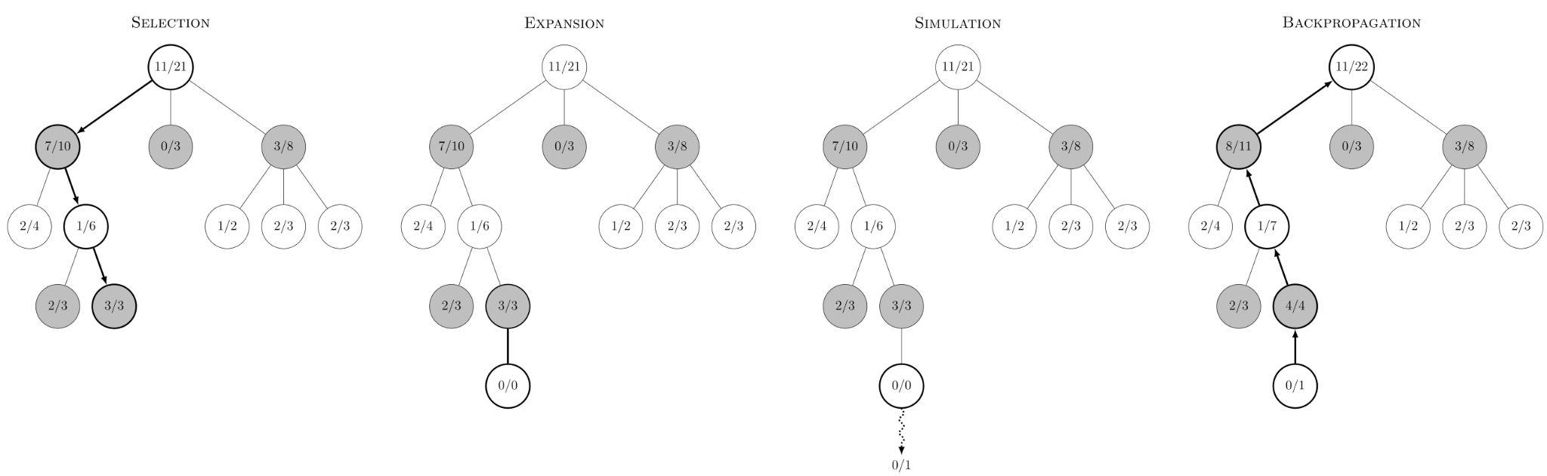
What is Monte Carlo?
Monte Carlo Tree Search (MCTS)- A search tree algorithm that uses simulations of the game board to approximate the best move.
MCTS works on 4 general steps repeated in order:
Select
Expand
Simulation
Backpropagation

Slide 9
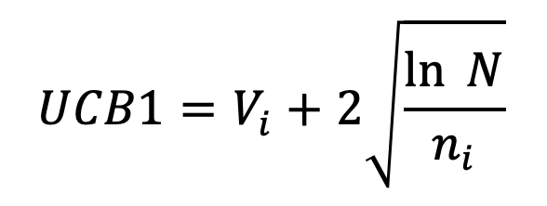
MCTS Step 1 - Select
In the Select Phase, starting from the root node, the tree keeps choosing a child node until that node is either:
  Not fully expanded
  In a terminal state
The child node chosen is based on the highest UCB1 value. This formula balances the following attributes:
  Exploitation: How well has the child node performed so far
  Exploration: How often has the child node been visited

Slide 10
MCTS Step 2 - Expand
Once the tree reaches the node that is not fully expanded, MCTS will add a child node to represent a possible action from that node.

Slide 11
MCTS Step 3 - Simulation
Then from that child node, the model will play out the 2048 game until no more legal moves can be found or the maximum limit depth has been reached.

Slide 12
MCTS Step 4 - Backpropagation
And last, the end result from the simulation is propagated back up the tree.
For each parent node, the visit count and score is updated.

Slide 13
Monte Carlo Demo

Slide 14
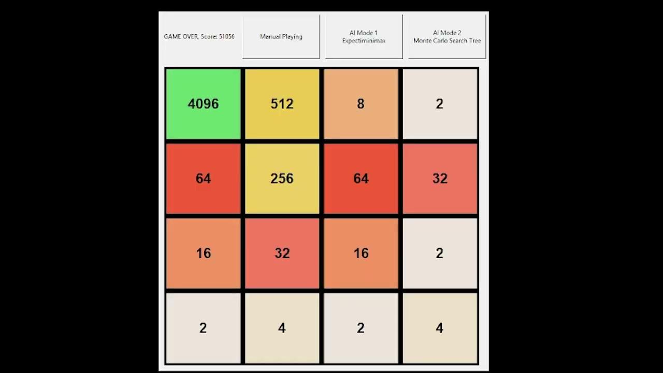
Expectiminimax Demo - 179s

Slide 15
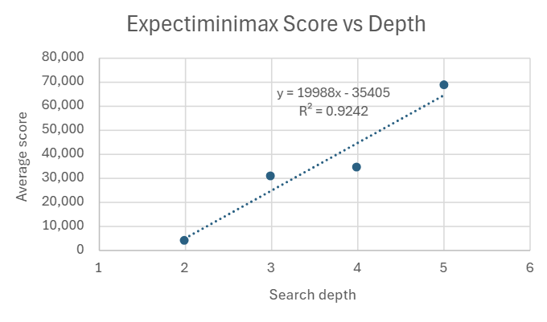
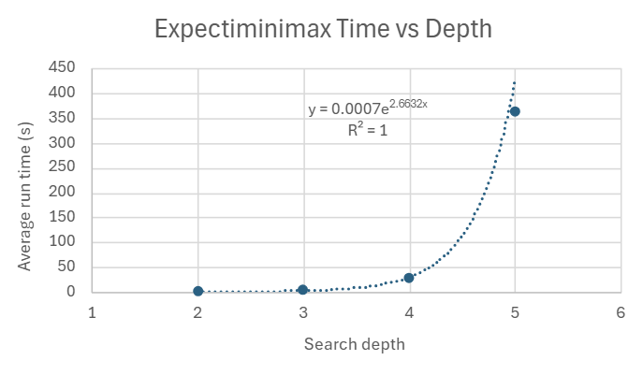
Results - Expectiminimax

Slide 16
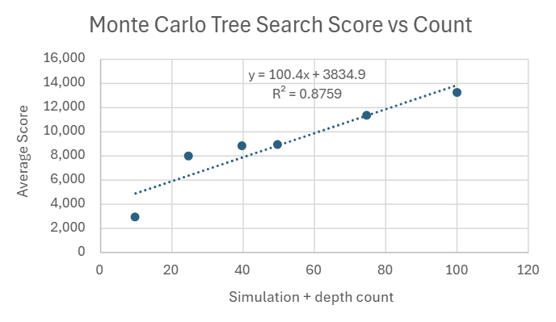
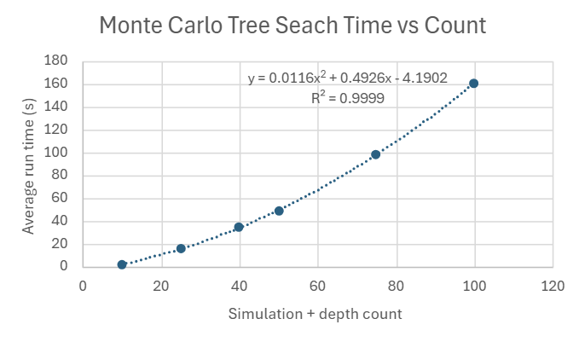
Results - Monte Carlo

Slide 17
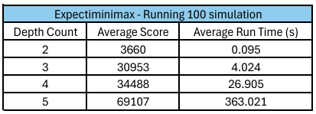
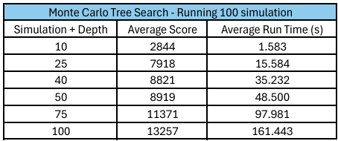
Conclusions on Data
Expectiminimax with a search depth of 3 scores higher than any of the Monte Carlo Tree Search simulation depth/counts we have tested thus far.
Expectiminimax also had a higher score-to-runtime ratio compared to Monte Carlo Tree Search.

Slide 18
Conclusions on Theory
The time complexity for Expectiminimax (EMM) is O(b^d) where
  b is the branching factor (how many branches from given state)
  d is the depth for the search tree
The time complexity for Monte Carlo Tree Search is O(s*d) where
  s is the total number of simulations for each state
  d is how many steps the board needed to simulate
2048 favors EMM much more due to its small branching factor.
MCTS would have performed better than EMM in a game where there were more options to move the player, such as Chess.
  Alpha Zero use a neural network and the MCTS algorithm.

Slide 19
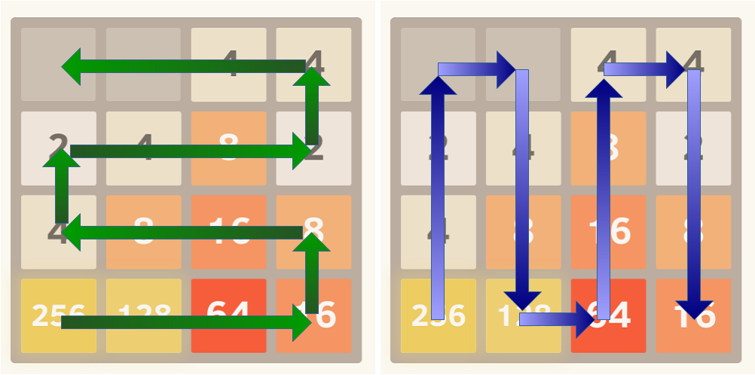
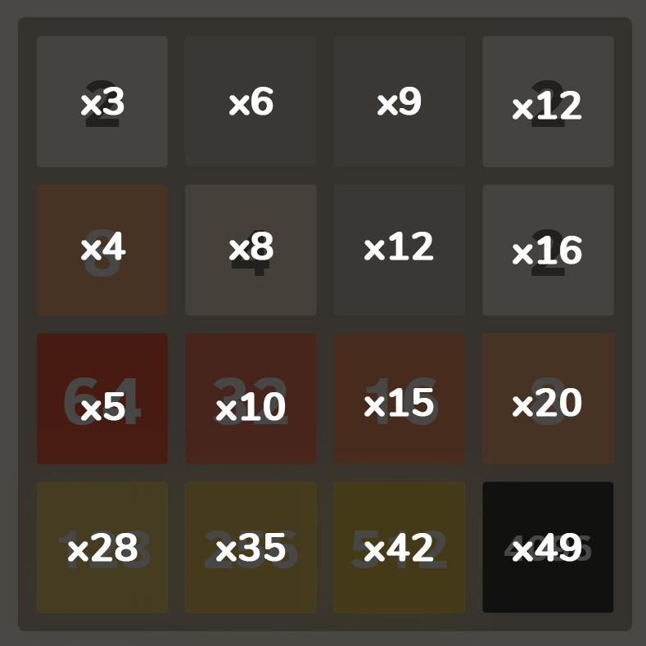
Potential Improvements
Better heuristic for 2048 in Monte Carlo Tree Search
Apply Alpha Beta pruning for Expectiminimax

Slide 20
References and Sources (1/2)
2048 Game Example:
https://classic.play2048.co/
Expectiminimax:
https://youtu.be/0fOLkZJ-Q6I?si=xEpKZ95S0Lz_9jlZ
https://github.com/mschrandt/2048
https://stackoverflow.com/questions/22342854/what-is-the-optimal-algorithm-for-the-game-2048
https://inst.eecs.berkeley.edu/~cs188/textbook/games/expectimax.html

Slide 21
References and Sources (2/2)
Monte Carlo:
https://www.geeksforgeeks.org/machine-learning/ml-monte-carlo-tree-search-mcts/
https://en.wikipedia.org/wiki/Monte_Carlo_tree_search
https://www.youtube.com/watch?v=Fbs4lnGLS8M
https://www.youtube.com/watch?v=UXW2yZndl7U
https://www.youtube.com/watch?v=62nq4Zsn8vc&t=1017s
https://www.youtube.com/watch?v=BEFY7IHs0HM&t=556s
https://stackoverflow.com/questions/57359229/ucb-formula-for-monte-carlo-tree-search-when-score-is-between-0-and-n
https://www.chessprogramming.org/UCT

Slide 22
Thank You!

